Slide 1

Where Does it Hurt?
Using Pain Scales to Communicate Effectively About Pain

Slide 2
Welcome to this short course on pain communication and the effective use of pain scales in clinical practice.
In a few minutes, I will ask everyone to share with the group your name, pronouns (if you feel comfortable giving them) and something interesting about yourself.

Slide 3
Course Participation Reminders
Just a few quick reminders about participation in this course:
Please be respectful of others in the room. If you need to take a call, text, or conduct other necessary business, please discreetly leave the room and use the hallway outside.
I welcome and appreciate note-taking and questions! Note-taking spaces have been provided in the Participants Guide.
I have a number of items available for anyone who would like to keep their hands busy as we work. Please feel free to help yourself.
Please let me know if you would like any of these materials in a different format to make them easier for you to access.

Slide 4

Instructional Goals
Effective assessment of and relief from pain requires clear communication between a patient and the health care provider concerning the nature of the pain, its onset and severity, goals for treatment, and possible outcomes.
This module
helps providers recognize potential barriers to effective communication about pain.
provides guidance on the use of three common types of pain scales to facilitate conversations about pain.
lets providers practice determining the appropriate pain scale to use in different sample situations.

Slide 5

How do we talk about pain?
It seems like physical pain should be easy to talk about, since almost everyone experiences pain at some point. However, it can be quite difficult.
Why is that?
Please pair up with someone nearby and share a few thoughts about why physical pain can be difficult to discuss.

Slide 6
It Just Hurts!
Many different problems can inhibit the successful communication of pain between patient and provider, including the following:
the use of different vocabulary or languages to understand and describe the sensations, effects, and areas of pain.
differing cultural and social values concerning pain, its severity, and its significance.
embedded and internalized biases that affect perceptions of pain.
physical, psychological, cognitive, or developmental impairments that make it difficult or impossible to describe or discuss pain.

Slide 7
It Just Hurts!
Additionally, conversations about pain can be impeded by:
an absence of a provider-patient relationship and/or medical history.
doubt about the existence of pain or the sincerity of the patient’s experience of that pain.
anxiety about pain medication addiction.

Slide 8
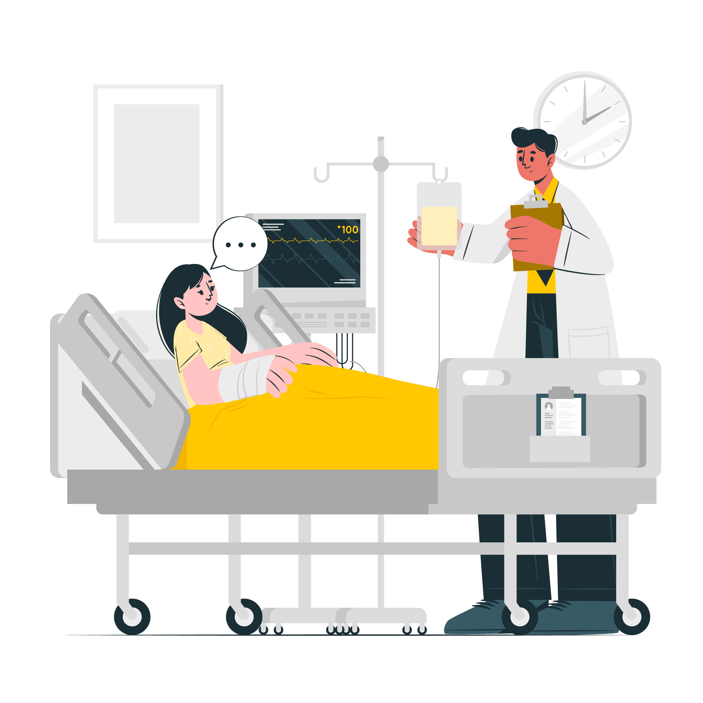
Patient self-report is “the single most reliable indicator of how much pain the patient is experiencing” (VHA, National Pain Management Coordinating Committee). Self-report of patient pain should never be replaced by the provider’s observations.
The provider can supplement the self-report with a physical exam and conversation with the patient.
When a patient has difficulty self-reporting or discussing pain, a pain scale can be used to get a sense of the severity and intensity of that pain.
There are many different types of pain scales. No single pain scale will work in every situation.

Slide 9
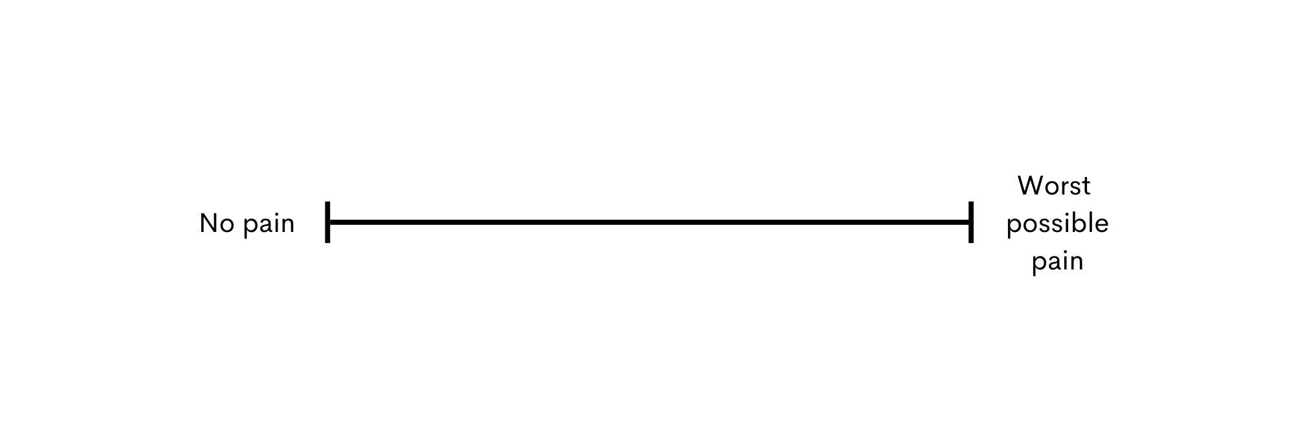

Visual Analog Scale (VAS)
A VAS is a line, typically 10cm long, with a descriptive anchor at each end.
The patient will mark a spot along the line that best represents the intensity or severity of pain they feel.

Slide 10
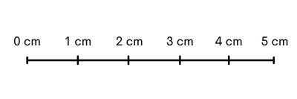
Visual Analog Scale (VAS)
Patients are asked to place a mark that corresponds to the severity of their pain.
Pain is measured on the scale from the left in cm.
These marks can be recorded in order to identify fluctuations in pain or to compare pain between different patients.
The scale can be administered in a manual or digital format.

Slide 11
Visual Analog Scale (VAS)
With your partner, please practice administering and measuring the VAS using the paper scales and rulers provided.
When you are done, discuss with your partner the benefits and drawbacks to using a VAS.

Slide 12
Visual Analog Scale (VAS)
Benefits
It can be administered very efficiently.
The scale minimizes translation needs.
It can be used repeatedly to understand and rate fluctuations of pain over time.
Drawbacks
The manual format can be difficult for those with low-mobility or cognitive difficulties to complete.
Measuring the responses manually can be time consuming.
The VAS is not suitable for very young children and comatose/non-communicative patients.

Slide 13
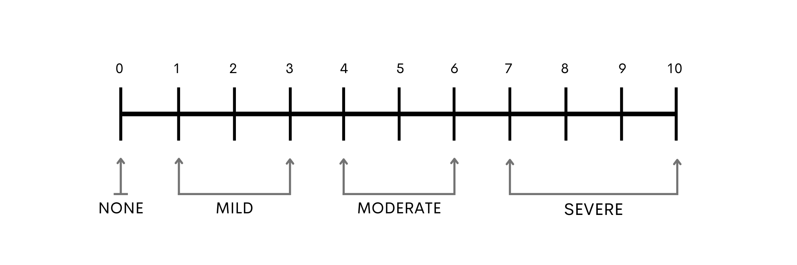
Numeric Ratings Scale (NRS)
A NRS is a type of VAS that uses numbers to help patients rate the severity and intensity of their pain.
Patients are asked to provide a number that corresponds to the intensity of their pain.
These marks can be recorded in order to identify fluctuations in pain or to compare pain between different patients.

Slide 14
Numeric Ratings Scale (NRS)
Examine the pain scale carefully and discuss it with your partner. Given our earlier conversation about common problems in pain communication, what do you feel are some benefits to using a NRS for patient self-report of pain? What might be some drawbacks to using this scale?

Slide 15
Numeric Ratings Scale (NRS)
Benefits
It can be administered very efficiently.
The scale minimizes translation needs.
It can be used repeatedly to understand and rate fluctuations of pain over time.
Drawbacks
It represents pain as a rigid metric with clear interval jumps (e.g., from a 3 to a 4).
It does not provide patients with a language to describe their pain (type, location, sensations, etc.)
It assumes a patient understands numerical intervals.

Slide 16

Wong-Baker FACES
The Wong-Baker FACES scale is designed to be used with patients who might struggle understanding or responding to a VAS or NRS.
The scale uses monochrome faces depicting different expressions of distress to help patients self-evaluate their physical pain.
With a partner, discuss why the Wong-Baker FACES scale might be especially useful for young children to use when self-evaluating pain. What might also be some drawbacks to using this scale?

Slide 17
Baker-Wong FACES Scale
Benefits
The scale can be used with young children who cannot understand a VAS or NRS.
The scale minimizes translation needs.
It can be used repeatedly to understand and rate fluctuations of pain over time.
The scale allows for both verbal and non-verbal patients to communicate their pain.
Drawbacks
The faces represent an external expression of pain. Some patients may confuse an emotional expression (e.g., the patient feels sad) and physical pain because the scale uses common emotional expressions.
It does not provide patients with a language to describe their pain (type, location, sensations, etc.)

Slide 18
Selecting a Scale
When do you use a specific scale? In what circumstances?
Some organizations require the use of a specific scale.
When it is your choice, determine the appropriate scale based on the situation.
The benefits to each scale are similar, but the drawbacks differ.
Select the scale based on minimizing the drawbacks in a given situation.
With your partners, discuss the scenarios provided in the participant guide workbook and determine which scale you would use and your reasoning for that choice.

Slide 19

Review and Assessment
Thank you all for your participation and discussion.
We’re now going to move on to the review and assessment portion of the course. The assessment can be found in the provided participant workbook.
In our next module, we’ll be covering comprehensive pain assessments.

